Slide 1
Beginner DAPM Joseph Lofgren & George Gilpatrick Cahill Swift FTA Drug and Alcohol Program National Conference May 11, 2021

Slide 2
Speakers
Joseph Lofgren – Cahill Swift, Minneapolis, MN
George Gilpatrick – Cahill Swift, Boston, MA
2

Slide 3
Topics
OVERVIEW: Regulations, Role of the Employer, Key Terms
KEY CONCEPTS: Why We Test, 3 Kinds of Test, Legal Background
PART 655: Program Requirements, Prohibitions, Test Types, Records Retention & Release, Information System
PART 40: Purpose, Subparts, Key Employer Subparts, Alcohol Testing, Drug Testing, Processing Results, Testing Problems & Refusals, Previous-Employer Checks, Public Interest Exclusions (PIEs)
VENDORS: “Service Agents,” Employer’s Responsibility & Role, Common Oversight Methods
NEXT STEPS: First Steps for Program Improvement
3

Slide 4
OVERVIEW
Regulations, Role of the Employer, Key Terms

Slide 5
49 CFR PART 655
Published by the Federal Transit Administration.
Full Title: Prevention of Alcohol Misuse and Prohibited Drug Use in Transit Operations.
Who is subject to testing (e.g., operators).
When testing must take place (e.g., after an accident).
5

Slide 6
FMCSA, FRA, and USCG Regulations
Each DOT mode regulates who must be tested, and under what circumstances (just like Part 655):
FMCSA = Part 382
FRA = Part 219
USCG = 46 CFR Parts 16 and 4
USCG is not within USDOT, but follows Part 40 for drug testing

Slide 7
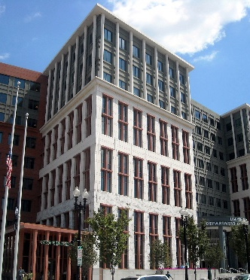
49 CFR PART 40
Published by USDOT’s Secretary’s Office (ODAPC).
Full Title: Procedures for Transportation Workplace Drug and Alcohol Testing Programs.
How to conduct drug and alcohol testing.
How to return an employee to duty after a violation.

Slide 8
The Role of the Regulated Employer
Implement a policy prohibiting drug use and alcohol misuse.
Perform previous-employer checks for new hires/transferees.
Conduct all required testing.
Take action as necessary.
Report testing summaries to DOT.

Slide 9
The Role of the Regulated Employer: Covered employers
Recipients (Grantees) of FTA Transit Funds:
5307: Urbanized Area Formula (Operating & Capital)
5309: Transit Capital Investment (Capital)
5311: Formula Grants for Rural Areas (Operating and Capital)
Serving population less than 50,000
5339: Buses and Bus Facilities (Capital)
Subrecipients and Contractors of FTA Grantee, when:
Recipient (grantee) uses the subrecipient/contractor to provide some or all of its safety-sensitive activities
Subrecipient/contractor uses vehicles purchased with FTA capital funding

Slide 10
The Role of the Regulated Employer: Which functions are covered?
Operating a revenue service vehicle, including when not in revenue service.
Operating a non-revenue service vehicle, when required to be operated by a Commercial Driver’s License (CDL) holder.
Controlling dispatch or movement of a revenue service vehicle.
Maintaining (including repairs, overhaul and rebuilding) a revenue service vehicle or equipment used in revenue service.
Carrying a firearm for security purposes.

Slide 11
The Role of the Regulated Employer: Others who are covered?
Volunteers who perform a safety-sensitive function if:
Required to have a CDL to operate the vehicle; or
Receive payment in excess of actual expenses
Taxicab operators/Transportation Networking Companies who contract with FTA recipients:
Unless patrons (using publicly subsidized vouchers) or other transportation providers can choose from a variety of taxicab operators/TNCs

Slide 12
The Role of the Regulated Employer: Who is exempt?
Maintenance contractors performing services:
For 5311 grantees
For 5307, 5309, or 5339 grantees serving areas with a population less than 200,000
On a one-time or limited, ad-hoc basis
Sub-contractors of maintenance contractors also exempt
Commuter rail operators:
Federal Railroad Administration (FRA)
Ferryboat Operators:
Covered mostly by Unites States Coast Guard
Need FTA Random Alcohol Testing

Slide 13
Common Acronyms
DER | = | Designated Employer Representative
DAPM | = | Drug and Alcohol Program Manager
BAT | = | Breath Alcohol Technician
ATF | = | Alcohol Testing Form
EBT | = | Evidential Breath Testing
CCF | = | Custody and Control Form
MRO | = | Medical Review Officer
SAP | = | Substance Abuse Professional
CFR | = | Code of Federal Regulations
CPL | = | Conforming Products List
ODAPC | = | Office of Drug and Alcohol Policy and Compliance (OST)
13

Slide 14
Key Definitions
DER: an employee authorized to take immediate action to remove employees from safety-sensitive duties. The DER also receives test results.
DAPM: an individual responsible for the implementation of the drug and alcohol testing program
CCF: the Federal Drug Testing Form, used to document every DOT urine collection
ATF: the DOT form, used to document every DOT alcohol test
EBT: a device approved by NHTSA for the evidential testing of breath
BAT: a person who instructs and assists employees in the alcohol testing process and operates an EBT
14

Slide 15
KEY CONCEPTS
Why We Test, 3 Kinds of Test, Legal Background

Slide 16
Three Kinds of Test
“Gatekeeper” Tests - Pre-safety-sensitive function tests:
Pre-employment
Return-to-duty
“Preventative” Tests - Deter prohibited behaviors:
Random
Follow-up
“Responsive” Tests - Detect employee violations:
Post-accident
Reasonable-suspicion
Follow-up
16

Slide 17
Legal Background
Public Safety vs. Employee Privacy.
Courts have consistently upheld DOT’s requirements and procedures.
E.g., 2009 Court of Appeals’ unanimous upholding of direct observation for return-to-duty and follow-up tests
17

Slide 18
PART 655
Program Requirements, Prohibitions, Test Types,
Records Retention & Release, Management Information System

Slide 19
Policy: What is it?
Statement describing the employer’s policy on prohibited drug use and alcohol misuse in the workplace.
Provides clear, concise guidelines to employees regarding the DOT/FTA substance abuse prevention program
Informs employees of prohibited conduct/behavior
Describes circumstances for testing
Defines consequences for rule violations
Provides a program implementation guide for the DAPM
19

Slide 20
Policy: Required Info
§655.15 Policy Statement Contents
Important 2018, 2019 updates:
1/1/2018 – “Opiates” → “Opioids”
1/1/2019 – If your policy states FTA random rate as “25%,” must update to “50%” or just “minimum rate.”
20

Slide 21
Policy: Required Info
You decide:
Negative-dilute → accept result or retest?
Pre-employment alcohol testing?
Zero tolerance or second chance?
Company consequences beyond FTA regulatory requirements?
21

Slide 22
Policy: Allowed Provisions
May include Drug Free Workplace Act.
May include Prescription/Over-the-Counter drug policy (encouraged).
FTA-Required Provisions vs. Employer Provisions:
Must not conflict
Must clearly differentiate
22

Slide 23
Policy: Getting One
Policy Checklist:
https://transit-safety.fta.dot.gov/DrugAndAlcohol/Tools/Checklist/PolicyReqsChecklist.doc
FTA Policy Builder Tool:
https://transit-safety.fta.dot.gov/DrugAndAlcohol/Tools/PolicyBuilder/CreatePolicy.aspx
Sample policies – Appendix A to the Best Practices Manual:
https://transit-safety.fta.dot.gov/DrugAndAlcohol/Publications/Documents/safety/bestpractices/bestpractices_oct2009.pdf
Be sure to modify for local circumstances.
23

Slide 24
Policy: Distribution
§655.16: requirement to disseminate policy
Must provide written notice to all covered employees of the policy
24

Slide 25
Education & Training
Display and Distribution of Materials - §655.14(a)
Informational materials about the effects of drugs & alcohol
Community service hotline for employee assistance
25

Slide 26
Training: All Covered Employees
Minimum of 60 minutes on drugs - §655.14(b):
Effects and consequences of prohibited drug use on personal health, safety, and the work environment.
Signs and symptoms that may indicate prohibited drug use.
Additional training (policy, alcohol, etc.) does not count towards 60 minutes.
FTA video available: https://transit-safety.fta.dot.gov/DrugAndAlcohol/Tools/DrugAwarenessVideo
26

Slide 27
Training: Supervisors
§655.14(c): Supervisors and/or other company officials authorized to make reasonable suspicion determinations must receive:
Minimum of 60 minutes on physical, behavioral, and performance indicators of probable drug use.
Minimum of 60 minutes on physical, behavioral, and performance indicators of probable alcohol use.
Training must occur prior to making any reasonable suspicion referrals.
27

Slide 28
Training: Record Keeping
Maintain documentation of training - 2 years minimum
Date and time it took place.
Who attended?
What topics were covered?
28

Slide 29
Prohibited Substances: Drugs
Use of these drugs is prohibited at all times:
Marijuana
Cocaine
Phencyclidine (PCP)
*Opioids
Amphetamines
Covered employees may be tested for drugs anytime they are on duty.
*Policies listing “opiates” as a prohibited/tested substance must be updated to list “opioids” instead.
29

Slide 30
Prohibited Substances: January 2018 Changes
Added 4 semi-synthetic opioids to testing panel:
Hydrocodone, oxycodone, hydromorphone, and oxymorphone.
Common brand names: Percodan®, OxyContin®, Percocet®, and Vicodin®.
Removed MDEA from Amphetamine panel.
Remove this from your policy if it’s currently listed.
30

Slide 31
Prohibited Alcohol Use
Alcohol use is prohibited:
While performing a safety-sensitive function.
Within 4 hours prior to performing a safety-sensitive function.
While on-call to perform a safety-sensitive function.
Allow employee the opportunity to acknowledge alcohol use.
Within 8 hours following an accident requiring an FTA post-accident test, or until the test has been conducted.
Covered employees may be tested for alcohol just before, during, or just after the performance of safety-sensitive functions.
31

Slide 32
Prohibited Behaviors: Refusals
As a covered employee, you have refused to test if you:
Fail to appear for a test within a reasonable time.
Fail to remain at the testing site until the testing process is complete.
Fail to attempt to provide a breath or urine specimen.
Fail to permit monitoring or direct observation, as required.
Fail to provide a sufficient quantity of breath or urine without a valid medical explanation.
Fail or decline to take a second test as directed by the collector or employer.
Consequences for refusing to test are the same as for a positive test (i.e., removal from duty and SAP referral).
32

Slide 33
Refusals continued
Admit adulteration or substitution of specimen to the collector/MRO.
Refuse to sign the certification at Step 2 of the ATF.
Not a refusal to decline to sign Step 5 of the urine collection CCF
Fail to remain readily available following an accident.
Provide an adulterated or substituted specimen, as verified by the MRO.
Refusing to test = positive test (remove from duty and SAP referral)
33

Slide 34
PRE-EMPLOYMENT TESTING
Three Situations
Drug test required; alcohol test optional
PE test refusals
Previous employer record checks
34

Slide 35
Pre-Employment Testing: Three Situations
Applicant
Current employee transfers to safety-sensitive position
Current employee returning from extended leave
No SS duties for 90+ consecutive days, AND removed from random testing pool
Do not confuse return-to-duty tests with pre-employment tests
return-to-duty tests are preceded by a positive/refusal, and are directly observed
35

Slide 36
Pre-Employment Testing: Drugs
DOT drug test required for all FTA safety-sensitive positions.
Verified negative result required prior to first SS duty
Includes training, in the yard, or any other movement or control of the vehicle
Not more than 90 days between PE test and first SS duty (and inclusion in random pool)
36

Slide 37
Pre-Employment Testing: Drugs – Four Examples
Date of Hire
Pre-Employment Test
Begin Safety Sensitive Function
Negative Result
Begin Training
Date of Hire
Pre-Employment Test
Begin Safety Sensitive Function
Negative Result
Begin Training
Date of Hire
Pre-Employment Test
Begin Safety Sensitive Function
Negative Result
Begin Training
Date of Hire
Pre-Employment Test
Begin Safety Sensitive Function
Negative Result
Begin Training
37

Slide 38
Pre-Employment Testing: Drugs
What happens if…
A PE test is cancelled?
A second test must be conducted.
A PE test is negative dilute?
May conduct a second test (refer to your policy).
Employee may begin SS functions.
38

Slide 39
Pre-Employment Testing: Alcohol
DOT alcohol tests are optional.
Must follow Part 40 procedures
Only after contingent offer of employment
Must be applied to all equally
BAC < 0.02 result required prior to first SS duty.
39

Slide 40
Pre-Employment Testing: Refusals
Different than other test types (random, post-accident, etc.).
Not a refusal if applicant:
Fails to appear for testing.
Leaves the collection site prior to commencement of test:
A drug test commences when donor accepts or selects the specimen cup.
An alcohol test commences when donor accepts or selects the mouthpiece.
40

Slide 41
Pre-Employment Testing: Key Points
Pre-employment drug test required.
Must receive negative result before first safety-sensitive duty.
41

Slide 42
REASONABLE SUSPICION TESTING
Goals
Authorization to Refer
Testing – Why?
Testing – When?

Slide 43
Reasonable Suspicion Testing: Goals
The Goal: Detection of any sign/symptom of drug use and/or alcohol misuse.
Identifying the specific substance is not important.
Are there signs and symptoms of drug use or alcohol abuse?
May authorize a drug test, alcohol test, or both.
43

Slide 44
Reasonable Suspicion Testing
A safety-sensitive employee must submit to a drug and/or alcohol test when the employer has a reasonable suspicion that the employee has used a prohibited drug or misused alcohol.
Reports, Tips, Fights, Signs or Symptoms, Etc.
Face-to-Face Evaluation
Test or Release

Slide 45
Authorized to Make a Referral
Who should be authorized to make a referral?
Company officials who will be in contact with safety-sensitive employees:
Dispatchers
Street supervisors
Maintenance supervisors
Employees (not authorized) should know who to contact if suspicious.
45

Slide 46
Authorized to Make a Referral
Training required:
60 minutes - physical, behavioral, and performance indicators of probable drug use.
60 minutes - physical, behavioral, and performance indicators of probable alcohol misuse.
Maintain documentation of training for at least 2 years.
46

Slide 47
Reasonable Suspicion Testing: Why?
Determination to test.
Based on specific, contemporaneous, articulable observations:
Appearance, behavior, speech, or body odor of employee
Sample Reasonable Suspicion Determination Form:
https://transit-safety.fta.dot.gov/drugandalcohol/tools
Observation by a trained company official or supervisor.
Only one trained company official/supervisor is required
47

Slide 48
Reasonable Suspicion Testing
A trained company official MUST be able to document specific signs/symptoms associated with drug or alcohol use observed during a face-to-face evaluation.
48

Slide 49
Reasonable Suspicion Testing: When?
Drugs - anytime on duty.
Alcohol - only if observations are made just before, during, or just after the performance of safety sensitive functions.
Employees must proceed immediately to collection site for testing (should be transported).
Same time limits as Post-Accident alcohol tests:
2 hours - document reason for delay
8 hours - cease if no test
49

Slide 50
Reasonable Suspicion Testing: Key Points
Physical signs and symptoms observed.
Ordered by trained company official/supervisor.
Drugs (anytime on duty), alcohol (just before, during, just after SS function).
Document, document, document.
50

Slide 51
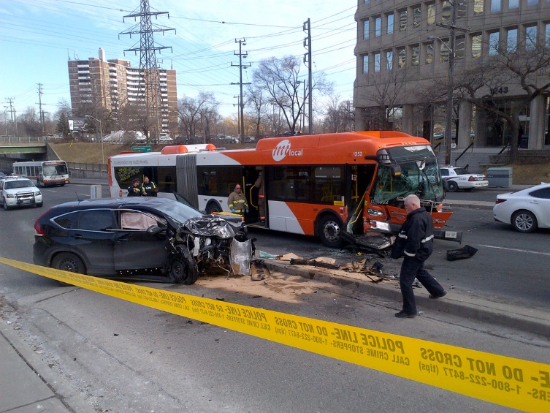
POST-ACCIDENT TESTING
What is an accident?
Testing decision
Who to test?
When to test?
Acceptance of other test results.

Slide 52
Post-Accident Testing Criteria
FTA defines an accident as…
An occurrence associated with the operation of a vehicle in which one or more of the following occur:
An individual dies.
An individual suffers a bodily injury and immediately receives medical treatment away from the scene.
One or more vehicles (including non-FTA funded vehicles) incurs disabling damage and must be towed away from the scene.
A rail car, trolley car or trolley bus, or vessel, is removed from operation.
52

Slide 53
Post-Accident Testing Criteria
What is a fatality?
Any individual dies at the scene.
The death was associated with the occurrence.
53

Slide 54
Post-Accident Testing Criteria
What is medical treatment away from the scene?
Any individual goes directly from the scene to receive medical treatment.
Transported by any means.
Does not require verification by the employer.
54

Slide 55
Post-Accident Testing Criteria
What is disabling damage?
Vehicle cannot proceed under its own power without further damage.
Vehicle cannot be easily repaired at the scene (headlights/taillights, turn signals, horn, tires, etc.).
Requires towing or transport away from the scene by another vehicle.
Determined by responding company official.
55

Slide 56
Post-Accident Testing Criteria
Factors that do not trigger FTA Post-Accident testing:
Dollar amount of damage
Driver citation
Insurance or company requirement
“Just to be safe”
At fault vs. preventable
56

Slide 57
Post-Accident Testing: Who to Test
Fatality:
Each surviving covered employee operating the public transit vehicle at the time of the accident.
Any other covered employee whose performance could have contributed to the accident.
No fatality:
Each covered employee operating the vehicle at the time of the accident – unless the employee’s performance can be completely discounted as a contributing factor.
Any other covered employee whose performance could have contributed to the accident.
57

Slide 58
Post-Accident Testing Decision
Decision to test/not to test.
Made by employer (company official, supervisor) at the scene.
Do not return to the garage/office to review video first
Use best information available at the time.
Any and all information on-site
Do not ‘reverse’ decision based on facts that may emerge later
Document decision-making process.
Decisions require judgment; not consensus.
58

Slide 59
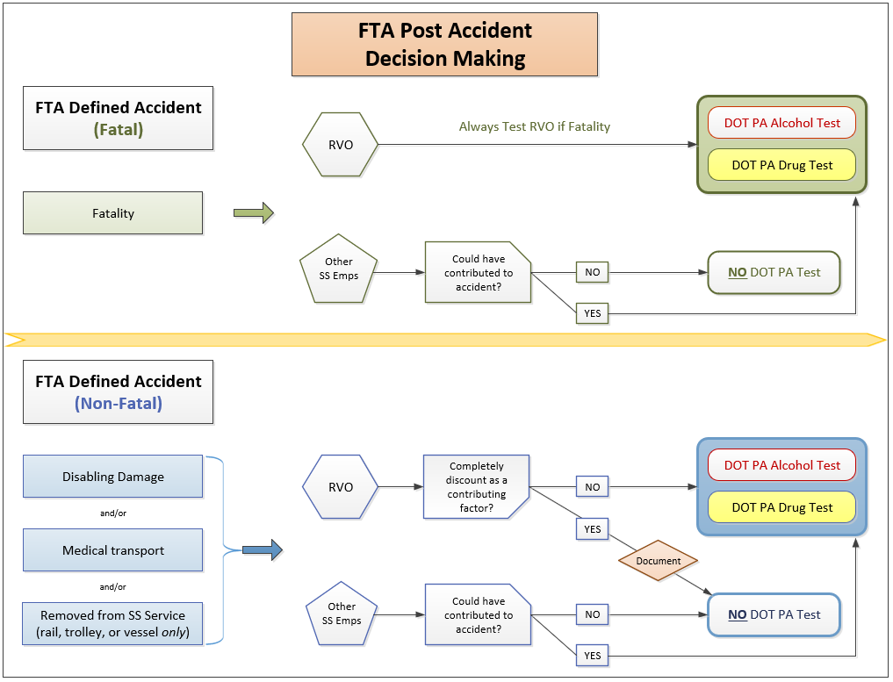
59

Slide 60
Post-Accident Testing: When to Test
Alcohol and drug tests must be performed as soon as possible.
Always treat injuries and cooperate with law enforcement first
Clock starts at the time of the accident.
Alcohol test (conducted first):
If no test within 2 hours – document why
Cannot test after 8 hours
Drug test:
Cannot test after 32 hours
Employee must give consent (cannot test if deceased/unconscious).
60

Slide 61
Acceptance of Other Test Results
Can use results from Federal, State, or Local officials in limited cases (if results are released).
Urine, blood, breath
Must document why FTA test could not be performed within required time period.
61

Slide 62
Post-Accident Testing: Key Points
Establish that at least 1 of the 3 criteria is met.
FTA testing is either REQUIRED or PROHIBITED.
Test any covered employee who could have contributed – ALWAYS alcohol and drug.
Document, document, document.
62

Slide 63
RANDOM TESTING
Minimum testing rates
Random selection
Consortiums
Random testing
Records Review

Slide 64
Minimum Random Testing Rates
Alcohol: 10% of total average covered employees.*
Drugs: 50% of total average covered employees.*
Testing rates describe the required number of tests each year, not the number of individuals tested.
Testing above minimum rates is allowed.
Does not need to be stated in the D&A policy
*Rates subject to change (published in Federal Register each year).
*Minimum rate for drugs changed from 25% to 50% on January 1, 2019.
64

Slide 65
Random Selection: Who Gets Selected?
Random pool must be kept up-to-date:
New hires
Terminations
Transfers to safety-sensitive positions
Long term leave (FMLA, Workers’ Comp, etc.)
Optional to remove; allowable to leave in pool
Only DOT safety-sensitive employees:
May include other modes (FMSCA, FAA, FRA, PHMSA, USCG)
65

Slide 66
Random Selection Method
Each employee must have an equal chance of being selected.
Scientifically valid selection method.
Random number generator (e.g., Microsoft Excel)
Random selection applications (commercial)
Human hand may not be involved.
Cannot pull name out of hat
Cannot determine type of test after selection
66

Slide 67
Random Selection: Using Alternates
Alternates may only be used if the originally selected employee cannot be tested during entire selection period.
Must have a legitimate reason for excusing the original employee (document excusal)
Alternates should be selected when original selection list is generated.
Must be identified as an alternate
If multiple alternates generated, use in order listed
67

Slide 68
Making Random Selections: Myths & Confusions
Random testing does not test everyone.
Randomization is NOT systematic testing
There is no MAXIMUM level of testing.
There are only minimums
You can alter the frequency of random draws.
68

Slide 69
Random Selection Lists
Restrict access to selection list (only you or your designee).
Keep list secure (locked cabinet, password-protected, etc.).
If random selection by TPA or other service provider:
Selection must occur just prior to new testing period
DER should dictate date and transmission method
List transmitted to DER in a secure, confidential manner
69

Slide 70
Life of the Selection List
When new selection list is received, previous list becomes invalid.
Do not attempt to test individuals from previous lists
After testing, keep selection list (along with master roster used to generate list) for at least 2 years.
70

Slide 71
Consortium
A pool of safety-sensitive employees from several smaller distinct groups.
Multiple employers
FTA grantee with contractors and/or subrecipients
State DOT with subrecipients
National contractor with multiple locations
71

Slide 72
Consortium
Consortiums must be compliant with testing minimums.
Individual employers might end up with testing rates above or below minimums at year-end
May include employees covered by multiple DOT agencies
Test at highest applicable rate
72

Slide 73
Random Testing
Testing must be unannounced and unpredictable.
Spread testing reasonably throughout:
All times of the day that SS functions are performed
Not only during DER’s workday
All days of the week that SS functions are performed
All weeks of the month, and months of the year
An employee notified must proceed immediately for testing.
Track when they arrive
73

Slide 74
Random Testing
What happens if the collection site closes early?
Hospital:
Ensure DOT qualified collectors
After-hours agreement:
May pay a premium
Agreement with individual collector.
74

Slide 75
Records Review: Graphic Analysis

Slide 77
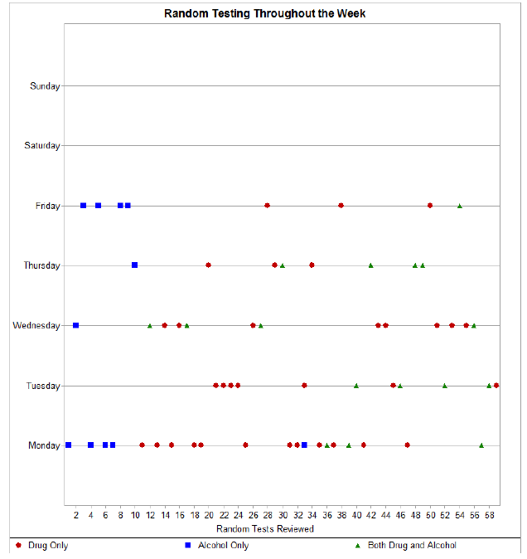
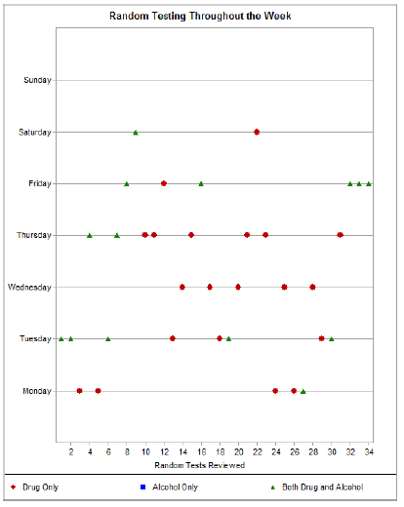
77

Slide 78
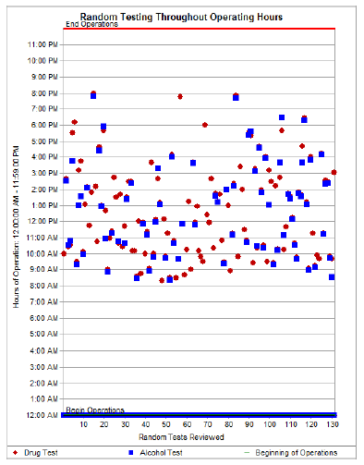
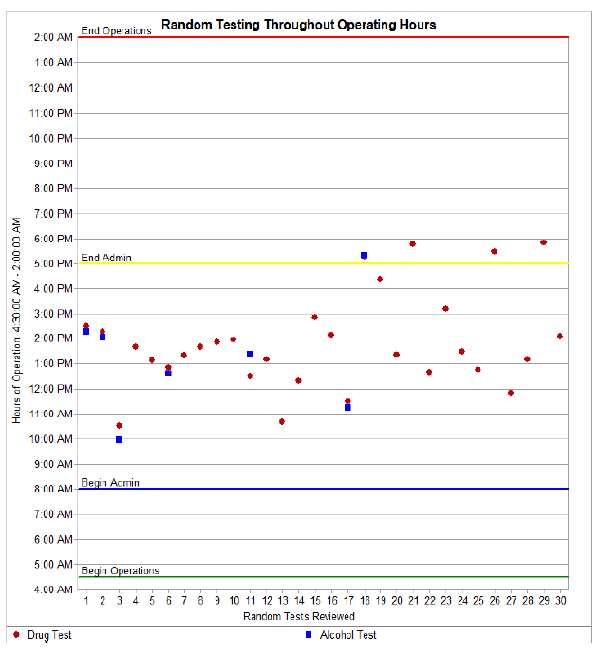
78

Slide 79
Random Testing: Key Points
At least 50% for drugs, 10% for alcohol
Update random pool before selection; keep list secure
Spread testing reasonably and unpredictably
Employees must proceed immediately
79

Slide 80
RETURN-TO-DUTY & FOLLOW-UP TESTING
Zero tolerance vs. second chance policy
Return-to-duty testing
Follow-up testing

Slide 81
Zero Tolerance vs. Second Chance
Both Zero Tolerance & Second Chance:
If a covered employee does any of the following…
refuses a test
has a verified positive drug test result
has a confirmed alcohol test result of 0.04 or greater
…the employee must be removed from safety-sensitive duty immediately, and referred to a qualified substance abuse professional
81

Slide 82
Zero Tolerance vs. Second Chance
Zero tolerance: employee is terminated.
Contact information for at least two DOT-qualified SAPs (or an SAP network) must still be provided
Second chance: employee may be allowed to return to safety sensitive duty after completion of the return-to-duty process.
82

Slide 83
Return-to-Duty Testing
Return-to-duty means second chance and that a violation has occurred.
Not conducted if employee is returning from long-term leave (FMLA, Workers’ Comp, etc. → pre-employment)
Conducted after employee successfully completes SAP’s treatment and/or education requirements.
Test is employer’s responsibility.
Employer decides if and when test will take place
83

Slide 84
Return-to-Duty Testing
Required in order to return an employee to DOT safety-sensitive duty.
Test can be for drugs, alcohol, or both.
SAP’s decision
Drug test must be directly observed.
If not, must send employee back for a second test
Must receive verified negative result to return.
84

Slide 85
Follow-Up Testing
Conducted once employee returns to safety-sensitive functions.
According to SAP’s written follow-up testing plan:
Minimum 6 tests in first 12 months
Maximum: 60 months (5 years) of testing
Duration extended for breaks in service
Can be for drugs, alcohol, or both
Only SAP can revise plan
85

Slide 86
Follow-Up Testing
Testing schedule (date and time of tests):
Must be unannounced and unpredictable
Drugs - any time employee is on duty
Alcohol - just before, during, or just after safety-sensitive duty
All drug tests must be directly observed.
Employee remains in random testing pool.
A random test is not a substitute for a follow-up test
86

Slide 87
Return-to-Duty and Follow-Up Testing: Key Points
Return-to-duty test after completion of SAP’s treatment plan
Follow-up schedule according to SAP’s plan
Follow-up tests unannounced and unpredictable
All tests directly observed
87

Slide 88
RECORDS RETENTION & RELEASE
Storage
Retention Period
Confidentiality
88

Slide 89
Records Storage
Secure location - with controlled access:
Locked cabinets
Electronic - password protected
Best Practice:
Keep drug and alcohol records separate from personnel or medical records to limit access
89

Slide 90
Minimum Retention - Summary
90

Slide 91
Confidentiality
Employer may release drug and alcohol information to:
Employee (written consent)
State oversight agency (SSO)
Grantee required to certify compliance
DOT Agency and Office of the Secretary (OST)
Lawsuit or grievance or other proceeding undertaken by the employee or on their behalf
e.g., worker’s compensation, unemployment compensation
National Transportation Safety Board (NTSB) as part of an accident investigation
91

Slide 92
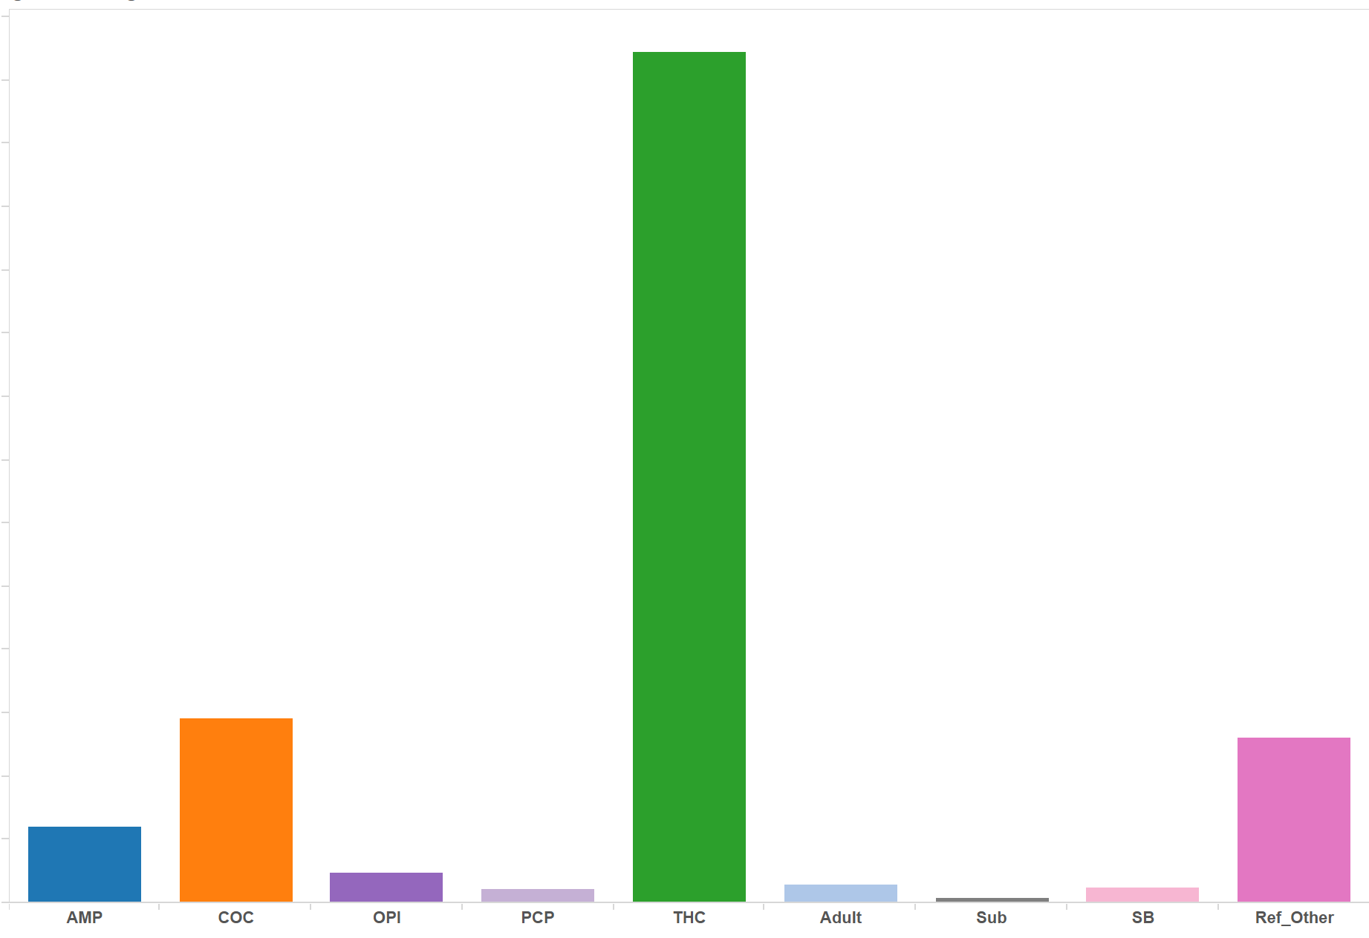
MANAGEMENT INFORMATION SYSTEM (MIS)
FTA reporting requirements
Reporting responsibilities
Multi-modal employers
How to submit

Slide 93
MIS: FTA Reporting Requirements
Prepare and maintain annual summary of testing results.
MIS report is “employer-based”:
Each employer submits a separate MIS with FTA results
No consortium reports
No combined reports
Submit results to FTA:
When requested (e.g., annual reporting, audit, triennial, etc.)
March 15 for annual MIS
Ensure accuracy and timeliness:
Grantees → contractors, subrecipients, TPAs, etc.
93

Slide 94
Reporting Responsibilities
Grantees – Direct Recipients, State DOTs, etc.
Ensure FTA has record of all subrecipients, covered contractors
FTA requests this information – December
Pass-through agencies – MPOs, county or city governments must still submit annual MIS
Likely “zeroed out” (no safety-sensitive employees or tests)
May NOT include contractor/subrecipient results
94

Slide 95
MIS: Multi-Modal Employers
When an employer is regulated by multiple DOT agencies, but: individual employees perform duties regulated by a single DOT agency:
Ex: Employer operates transit buses (FTA) and school buses (FMCSA), but each employee operates only one type of bus
Submit separate agency specific MIS forms
Do not double report
95

Slide 96
MIS Reporting Questions?
FTA Drug and Alcohol Hotline (US DOT Volpe Center)
Call (617)494-6336
Email fta.damis@dot.gov
Online guidance
http://transit-safety.fta.dot.gov/DrugAndAlcohol/DAMIS
96

Slide 97
PART 40
Purpose, Subparts, Key Employer Subparts, Tests and Results Processing, Testing Problems & Refusals, Section 40.25 (Previous-Employer Checks), Public Interest Exclusions (PIEs)

Slide 98
Part 40’s Purpose
Title says a lot: “Procedures for Transportation Workplace Drug and Alcohol Testing Programs.”
Section 40.1(a) states: “This part tells all parties who conduct drug and alcohol tests required by Department of Transportation (DOT) agency regulations how to conduct these tests and what procedures to use.”
An umbrella regulation that tells employers and their vendors – across all regulated modes – how to conduct drug and alcohol testing.
98

Slide 99
Eighteen Subparts
Subpart A—Administrative Provisions
Subpart B—Employer Responsibilities
Subpart C—Urine Collection Personnel
Subpart D—Collection Sites, Forms, Equipment and Supplies Used in DOT Urine Collections
Subpart E—Urine Specimen Collections
Subpart F—Drug Testing Laboratories
Subpart G—Medical Review Officers and the Verification Process
Subpart H—Split Specimen Tests
Subpart I—Problems in Drug Tests
Subpart J—Alcohol Testing Personnel
Subpart K—Testing Sites, Forms, Equipment and Supplies Used in Alcohol Testing
Subpart L—Alcohol Screening Tests
Subpart M—Alcohol Confirmation Tests
Subpart N—Problems in Alcohol Testing
Subpart O—Substance Abuse Professionals and the Return-to-Duty Process
Subpart P—Confidentiality and Release of Information
Subpart Q—Roles and Responsibilities of Service Agents
Subpart R—Public Interest Exclusions
99

Slide 100
Key Subparts for the Transportation Employer
Subpart B—Employer Responsibilities
Subpart E—Urine Specimen Collections
Subpart I—Problems in Drug Tests
Subpart L—Alcohol Screening Tests
Subpart M—Alcohol Confirmation Tests
Subpart N—Problems in Alcohol Testing
Subpart O—Substance Abuse Professionals and the Return-to-Duty Process
100

Slide 101
Drug Test Results: Employer Action
Notification of a verified positive drug test result or refusal to test:
Immediately remove the employee from safety-sensitive duties
By DER (Designated Employer Representative)
Refer employee (or applicant) to qualified SAP
101

Slide 102
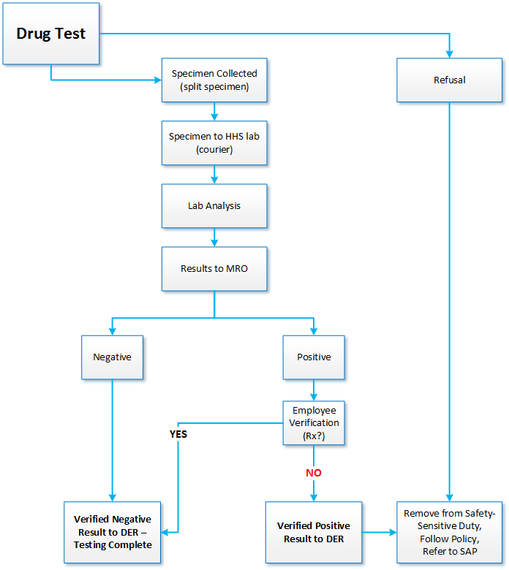

Slide 103
Alcohol Test Results: Employer Action
Confirmation result of 0.04 or greater or refusal to test:
Immediately remove the employee from safety-sensitive duties
By DER
Refer employee to qualified SAP
Confirmation result of 0.02-0.039:
Immediately remove the employee from safety sensitive duties for at least 8 hours or until next scheduled shift
NO SAP referral
May apply disciplinary policy under own authority
103

Slide 104
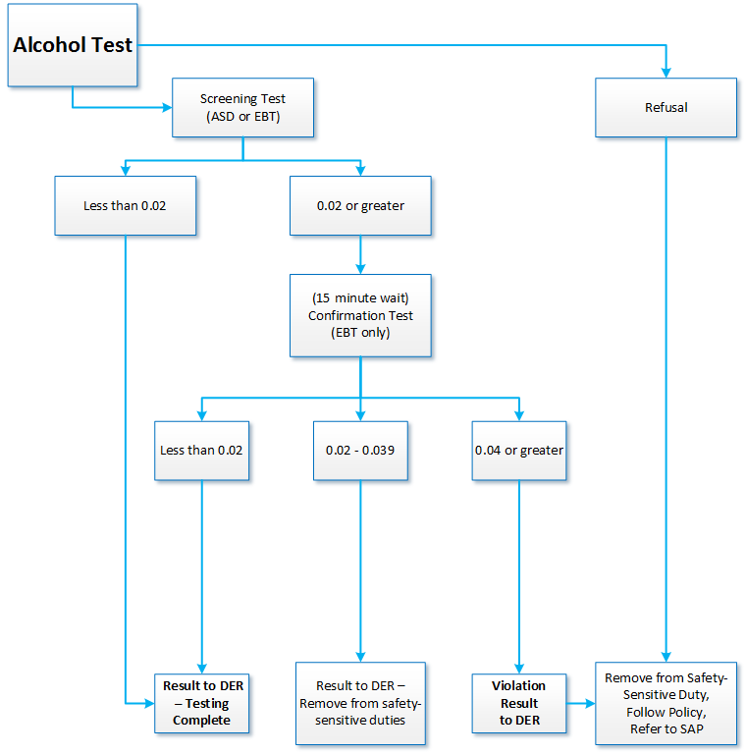

Slide 105
Problems in Testing & Testing Refusals
Refusal to test (see slides 33-34):
Make determination
Take action (same DOT consequences as positive)
“Shy Bladder” (§40.193) and “Shy Lung” (§40.265):
Five days for medical evaluation (employee keeps working)
For drug test, physician must be acceptable to MRO
Dilute-negative drug test:
You must have a policy in place
Cancelled test:
Neither positive nor negative; can’t count toward MIS total
105

Slide 106
Previous Employer Records Check
As a potential employer, you must:
Obtain written consent from applicants to obtain drug and alcohol testing information from DOT employers during previous two years
Contact previous employers - written consent must accompany the request
Separately, ask applicant/transferee whether he or she has tested positive or refused a DOT pre-employment test in the previous two years -§40.25(j)
106

Slide 107
Previous Employer Records Check
Request this information from any previous DOT employers:
Alcohol test results higher than 0.04
Verified positive drug tests
Test refusals
Other violations of the DOT drug and alcohol regulation
If appropriate, documentation of successful completion of return-to-duty process
107

Slide 108
Public Interest Exclusions (PIEs)
Used by DOT to protect public interest (safety).
Used to remedy serious (generally ongoing) noncompliance.
Bars service agent – can apply to all divisions/affiliates/departments – from participating in DOT testing.
Can last up to five (5) years.
108

Slide 109
VENDORS
“Service Agents,” Employer’s Responsibility & Role, Common Oversight Methods

Slide 110
Service Agents
Includes (but not limited to):
TPA
MRO
SAP
Collectors
BATs/STTs
Consultants
All must follow Part 40 guidance
May not act as employer/DER
*New*: Must subscribe to ODAPC’s email list serve
© Can Stock Photo / sima
110

Slide 111
Common Oversight Methods
If your vendors are not compliant – you are not compliant.
Specifics not prescribed by DOT:
DOT allows to request qualifications, exam certifications, etc.
Best Practices (for Collection Site):
Perform periodic on-site reviews (if applicable)
Review testing records - CCFs and ATFs
Require correction/cancellation if appropriate
111

Slide 112
Collection Sites: On-Site Review
Review:
Collector Qualifications – §40.33
BAT / STT Qualifications – §40.213
EBT on NHTSA Conforming Products List?
Ensure EBT prints
Calibration Logbook – Follows Quality Assurance Plan (QAP) for the device (§40.233)
Clock on EBT is correct – Daylight Savings
112

Slide 113
Collection Site Integrity: The Risks
Substitution of specimen
Donor’s ability to dispose of or conceal paraphernalia brought into the enclosure
Donor’s ability to access paraphernalia already in the enclosure
Hiding places even for small objects
Dilution of specimen
Adulteration of specimen
113

Slide 114
Collection Site Integrity: The Solutions
Secure all water sources
Remove sources of adulterants
Eliminate undetected access
Secure/eliminate areas for hiding/concealing
Ledges, cabinets, trash receptacles, under sink areas, drop-ceiling tiles
114

Slide 115
Collection Site: CCF Review
Step 1
A: Employer name, address, phone # - required information
TPA information allowed – must transmit to employer
B: MRO – current contact information
D: DOT Agency – FTA, not FMCSA (most common error)
E: Reason for test
115

Slide 116
Collection Site: CCF Review
Step 1
FTA violations do NOT get entered into the FMCSA Clearinghouse
CDL numbers are NOT required on drug testing form
116

Slide 117
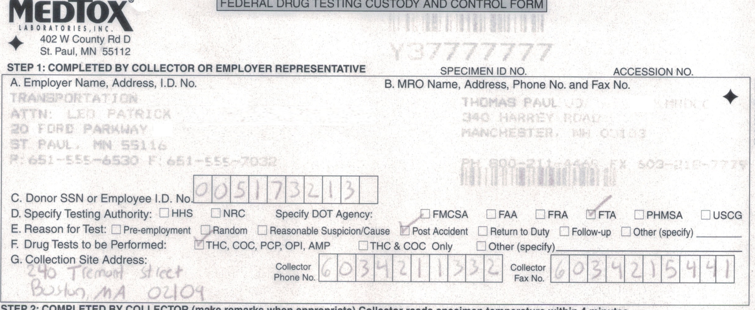
117

Slide 118
Collection Site: CCF Review
Step 2
Directly observed:
Always for return-to-duty and follow up tests
Other reasons per §40.67
Observed not checked when required?
Call collection site… if not observed, send donor back immediately
Remarks required if:
Shy bladder
Directly observed by a same gender observer (if different than collector)
Temperature out of range
Employee not cooperating (won’t sign CCF, print name, etc.)
118

Slide 119
Collection Site: CCF Review
Step 3
Specimen is split into two bottles
Collector affixes seals to bottles
Collector writes date on seals
Collector instructs donor to initial each seal
Fold back page 1 and donor completes Step 5
119

Slide 120
Collection Site: CCF Review
Step 5
Employee’s name, telephone number, and date of birth
Date of test
Employee signature
If no signature, is this documented in the Remarks Section of Step 2?
120

Slide 121
121

Slide 122
Collection Site: CCF Review
Step 4
Collector name, signature, time and date
§40.209(b)(9) – Must include specific courier name
“Courier” not allowed - must be specific (e.g. FedEx, DHL, etc.)
122

Slide 123
123

Slide 124
Collection Site: CCF Review
General:
DOT CCF?
“Federal Drug Testing Custody and Control Form”
All fields complete
Dates are correct and consistent
Writing is legible
You received the correct copy (Copy 4 – Employer)
If applicable, alcohol test before drug
124

Slide 125
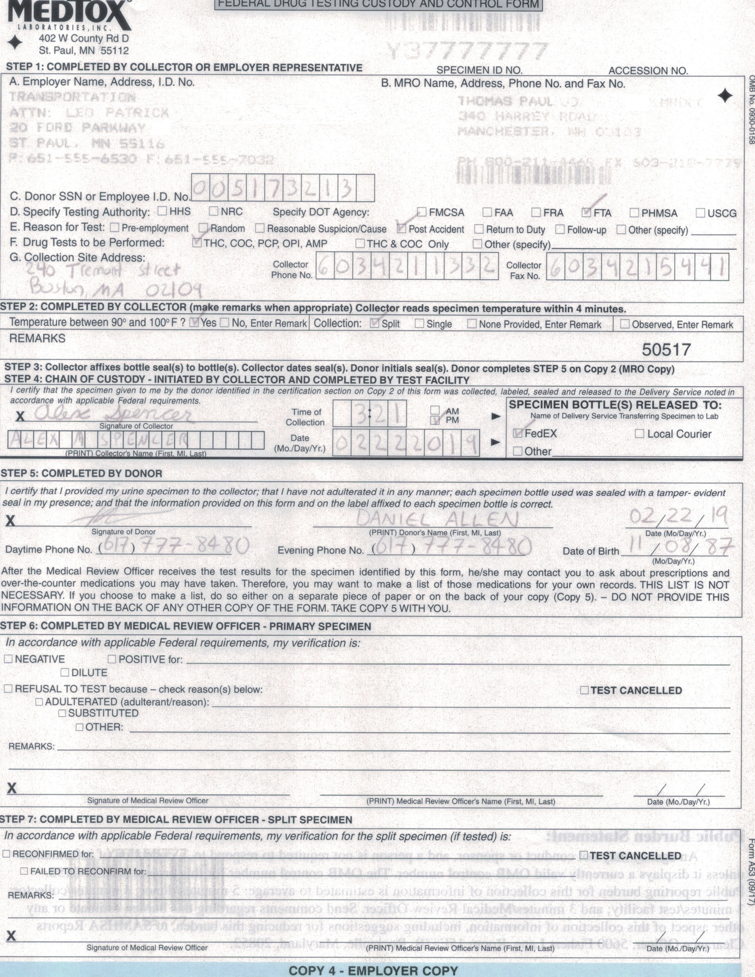
125

Slide 126
Collection Site: CCF Review
What if errors are found?
Employer must correct error – contact collection site:
Missing information (collector)
Supply missing information in writing
Supply statement that information is correct and accurate
Same business day
126

Slide 127
Collection Site: ATF Review
General:
DOT ATF?
“U.S. Department of Transportation Alcohol Testing Form”
All fields complete
Writing is legible
Result affixed to form with tamper evident tape or printed?
You received the correct copy (Copy 1 – Employer)
Alcohol test before drug
127

Slide 128
NEXT STEPS
First Steps for Program Improvement

Slide 129
Next Steps: Policy
Use policy checklist
Send draft to FTA for courtesy review
Use FTA Policy Generator
129

Slide 130
Next Steps: Self-Audit
What times are your earliest and latest random tests in the last 2 years?
What day/time has no safety-sensitive employee ever been tested?
Are your employees proceeding immediately to random tests?
Are your post-accident tests conducted in a timely fashion?
130

Slide 131
Next Steps: Vendor Relations
Visit your collection site
Examine your random selection program and request changes
131

Slide 132
Technical Assistance
Iyon Rosario – FTA Drug & Alcohol Program Manager
(202) 366-2010, iyon.rosario@dot.gov
FTA D&A Project Office (US DOT Volpe Center)
Hotline: (617) 494-6336, fta.damis@dot.gov
Mike Redington: (617) 494-2197, michael.redington@dot.gov
Lori DeCoste: (617) 494-2379, lori.decoste@dot.gov
Felicity Shanahan: (617) 494-3915, felicity.shanahan@dot.gov
Jennifer Gissel: (617) 494-3875, jennifer.gissel@dot.gov
132

Slide 133
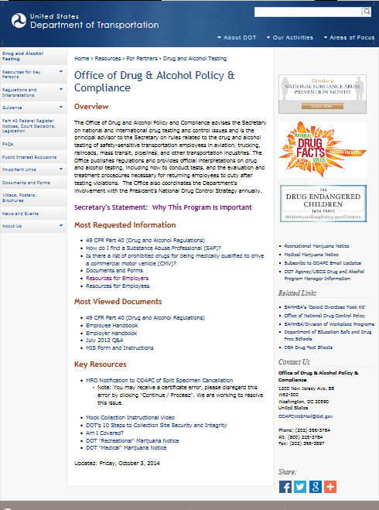
www.transportation.gov/odapc
133

Slide 134
Questions?
Joseph Lofgren Cahill Swift 617-314-9208 jlofgren@cahillswift.com

